Slide 1
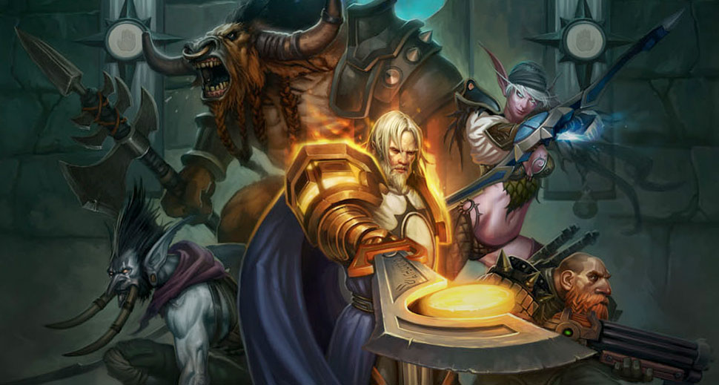
GA 3331 – Game Prototyping
Week 4
Unity

Slide 2
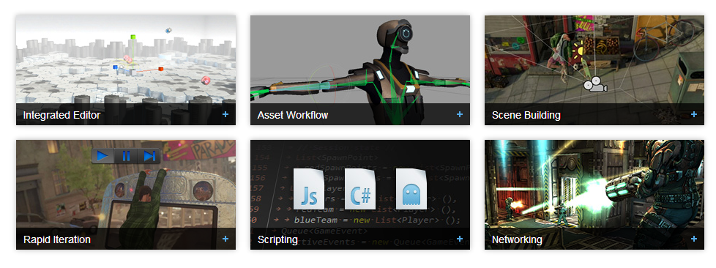
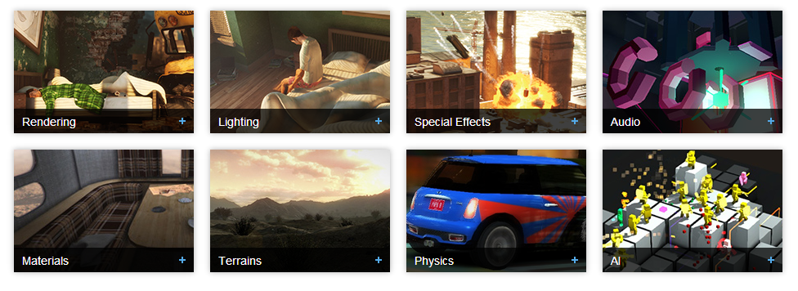
What is Unity?
Pro/Free versions
Game toolkit - Editor/Scripting/Renderer

Slide 3
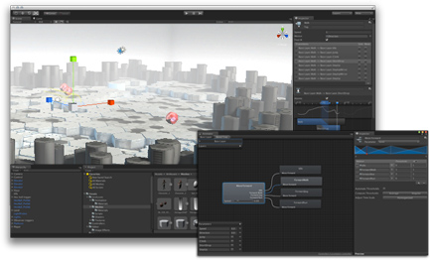
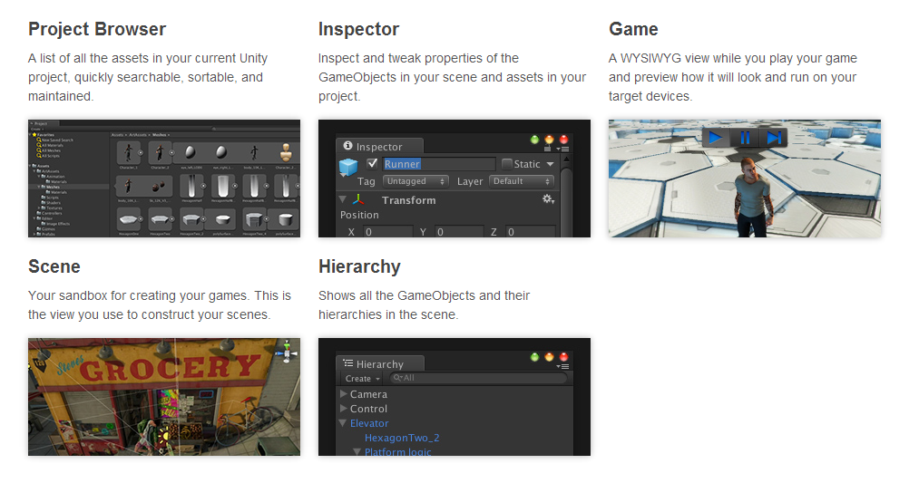
What is Unity?
The Editor + Asset store

Slide 4
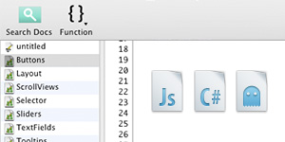
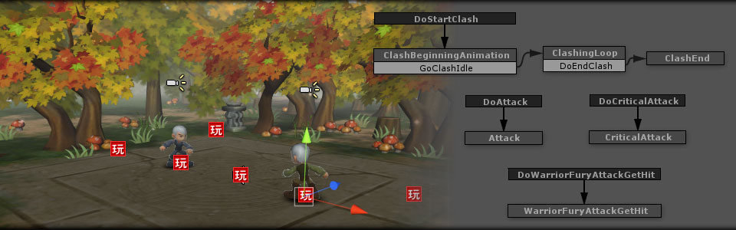
What is Unity?
Scripting

Slide 5
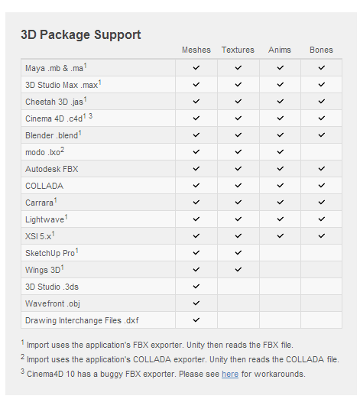
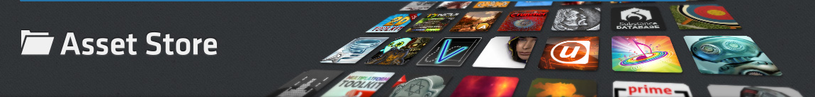
What else is Unity?
Asset management
Asset Store

Slide 6
Lab #1
Working with the unity editor

Slide 7
Lab #2
Playmaker tutorial

Slide 8
Lab #3
Lab work!

